Slide 1


Commoditize Your CI Compute:
Spot Instances Without the Spotty Reliability
Felicitas Pojtinger
@pojntfx

Slide 2
Chapters
Intro
Private Beta
Lock-In
Problem Landscape
Demo
Tech Stack

Slide 3


Felicitas
Pojtinger
Fediverse:
Bluesky:
Github:
LinkedIn:
Web:
@pojntfx@mastodon.social
@felicitas.pojtinger.com
@pojntfx in/pojntfx felicitas.pojtinger.com

Slide 4
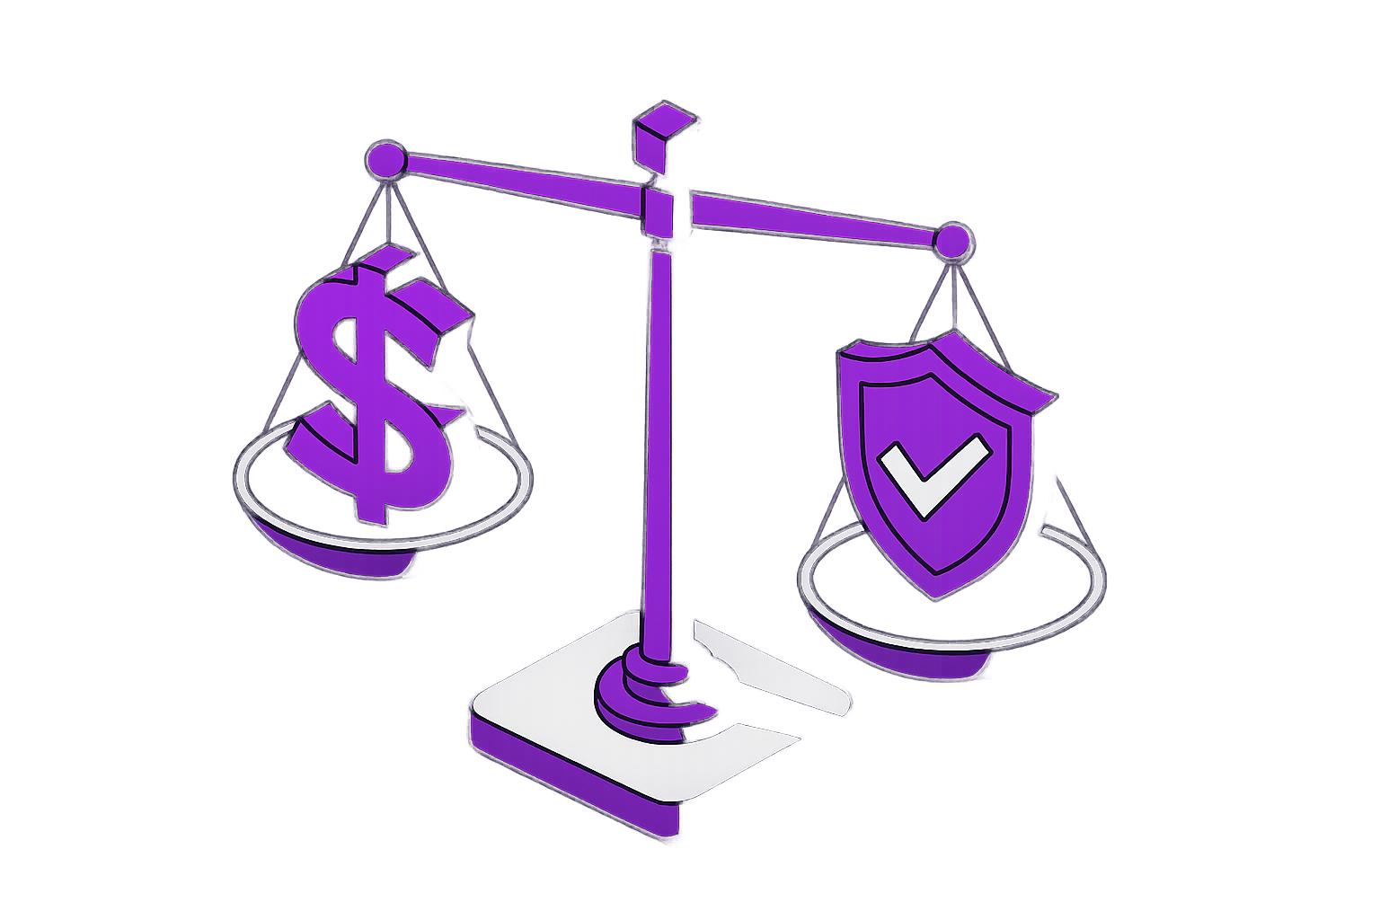
"Pay full price or risk losing critical work"
30-120s termination notice
70-90% savings

Slide 5
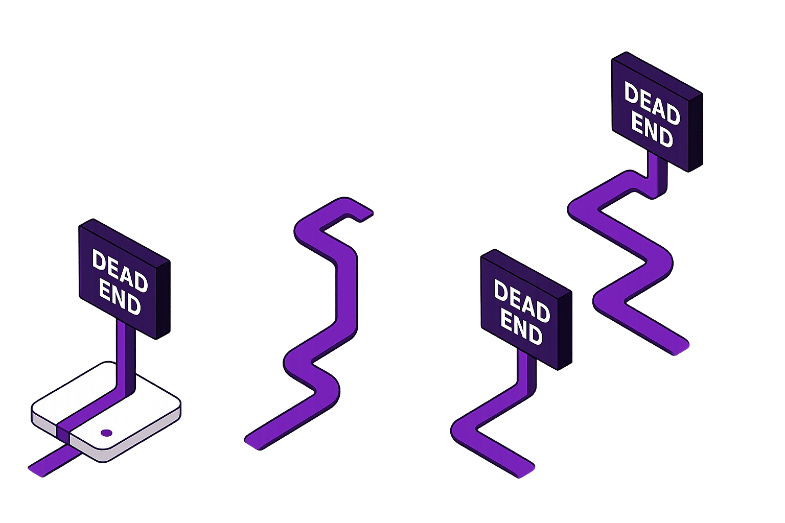
❌ Complex custom checkpointing
❌ Spots only for stateless jobs
❌ Expensive on-demand instances
❌ Accept failures and retry

Slide 6
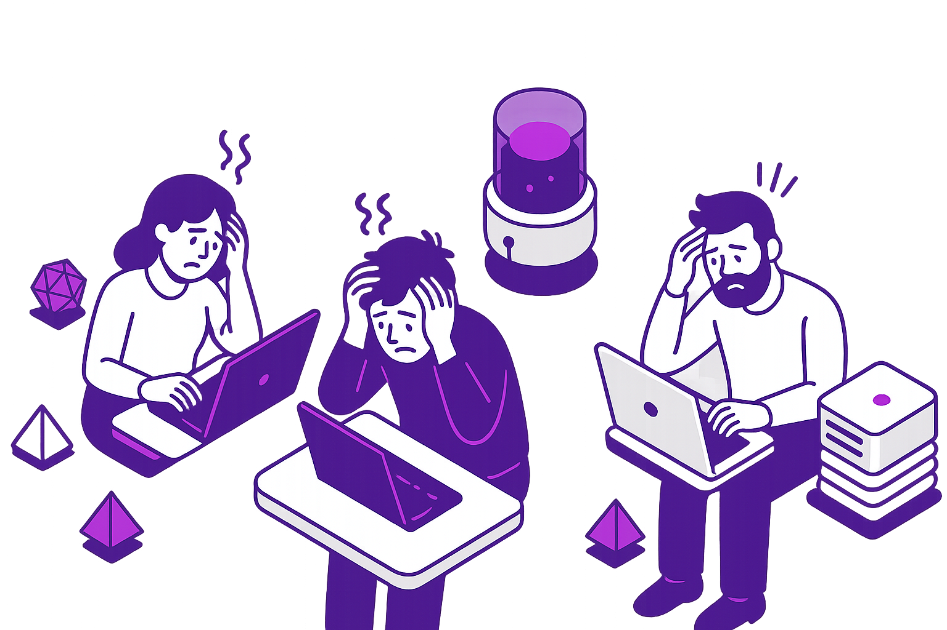
Fewer tests, shorter fuzzing sessions
€$¥
Infrastructure limitations restrain engineering capacity

Slide 7
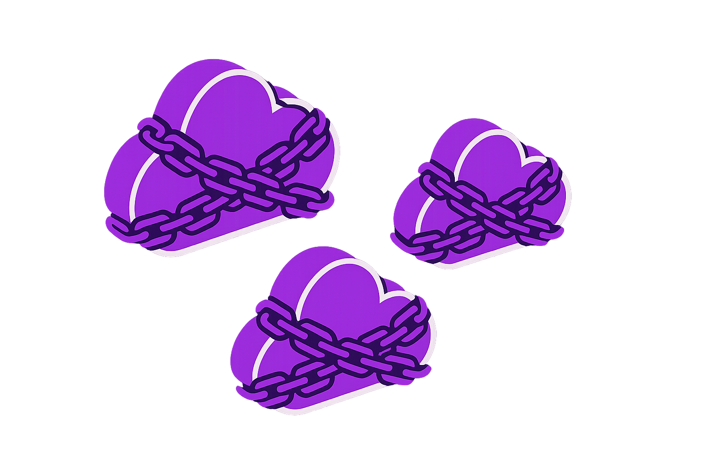
No workload portability
“It’s a big club and you’re not in it”
Vendor lock-in

Slide 8
“A unified, failure-proof compute fabric”

Slide 9
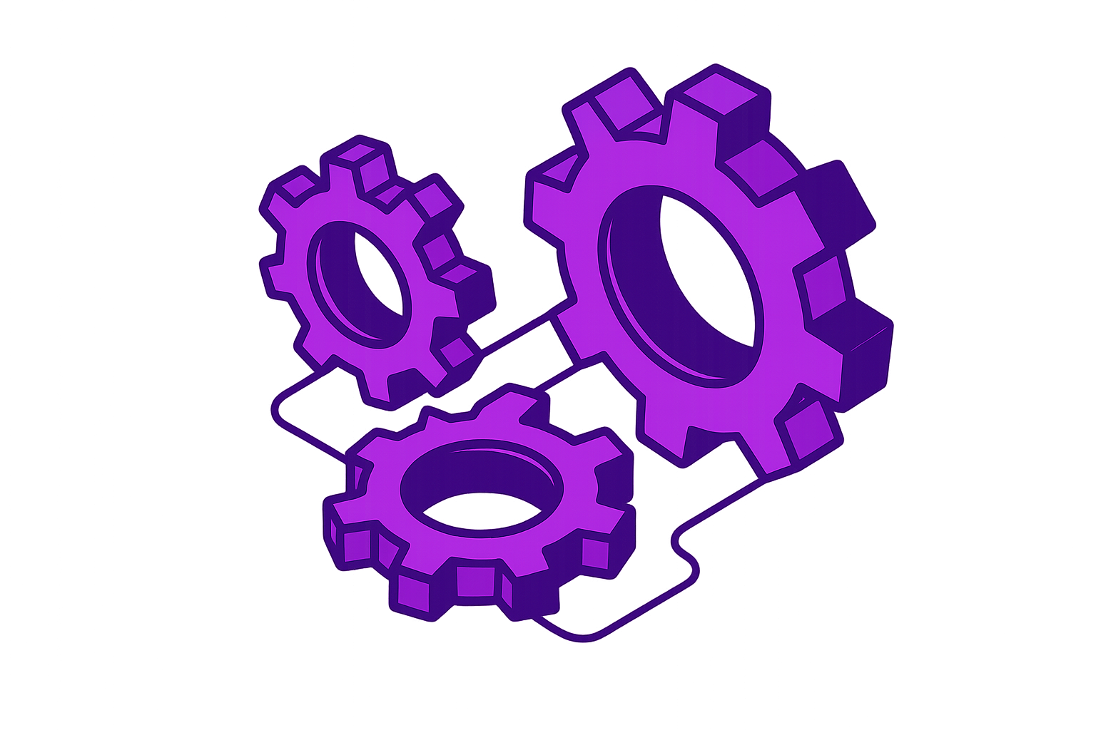
Cross-cloud compatibility: AWS, GCP, Azure, on-prem
Zero application changes needed
Live migration

Slide 10
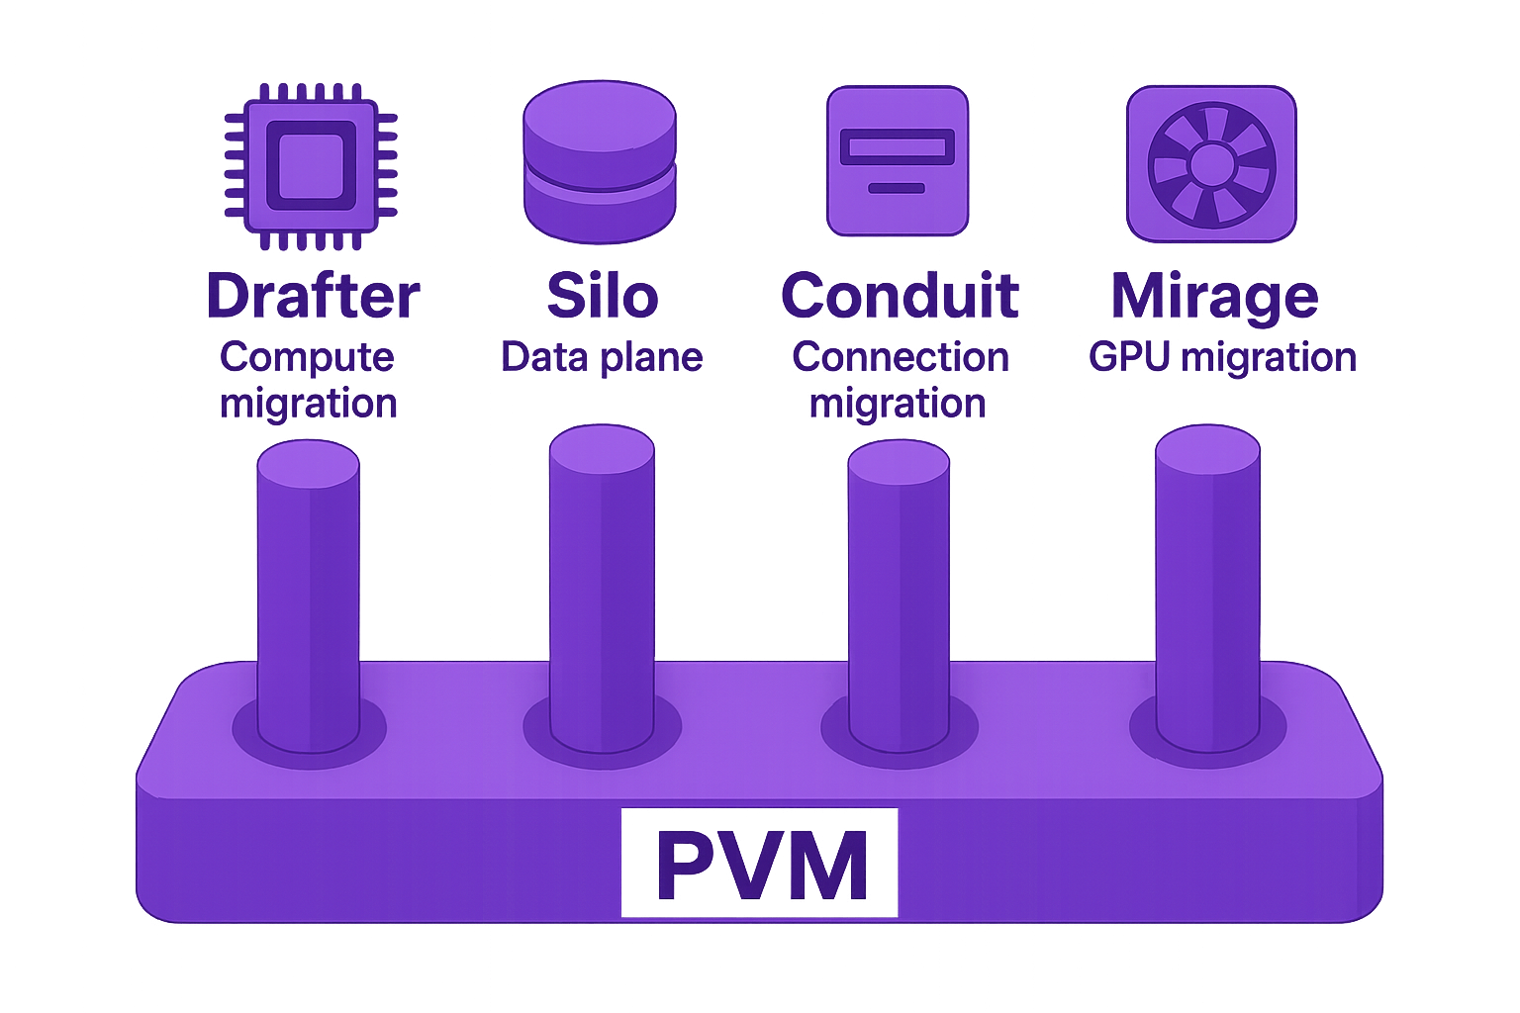

Slide 11
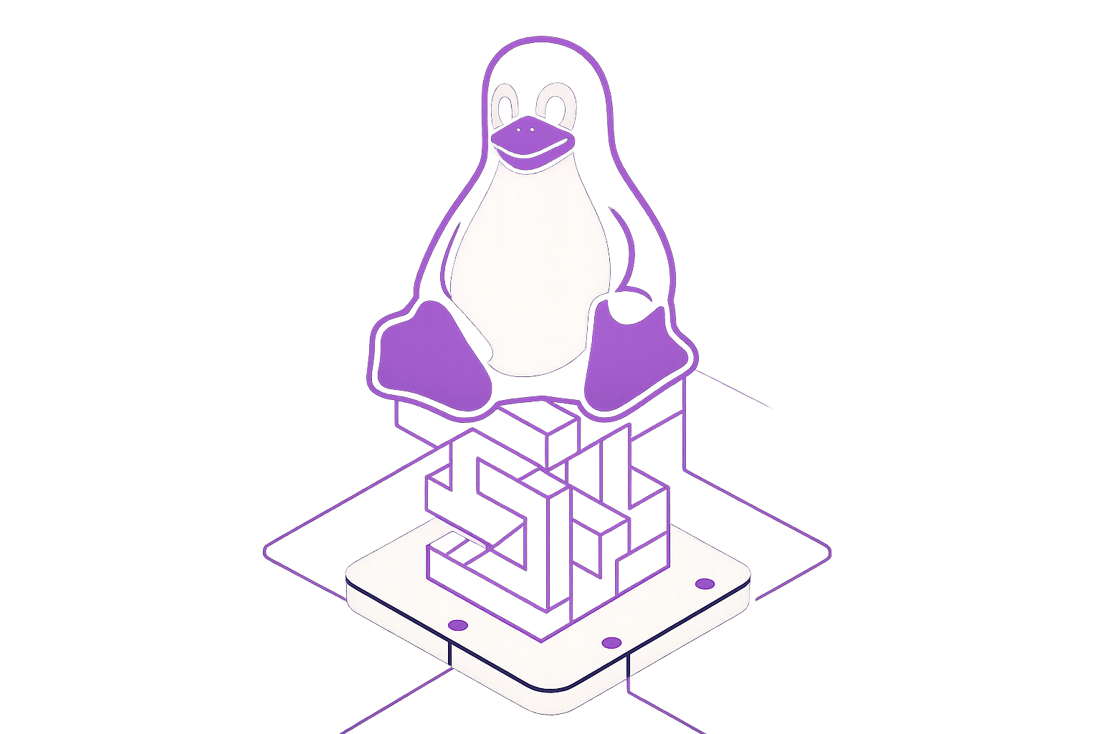
PVM: Pagetable Virtual Machine
Initial patches submitted in 2024
Works with existing hypervisors (QEMU, Cloud Hypervisor, Firecracker)
No need for hardware virtualization or emulation support

Slide 12
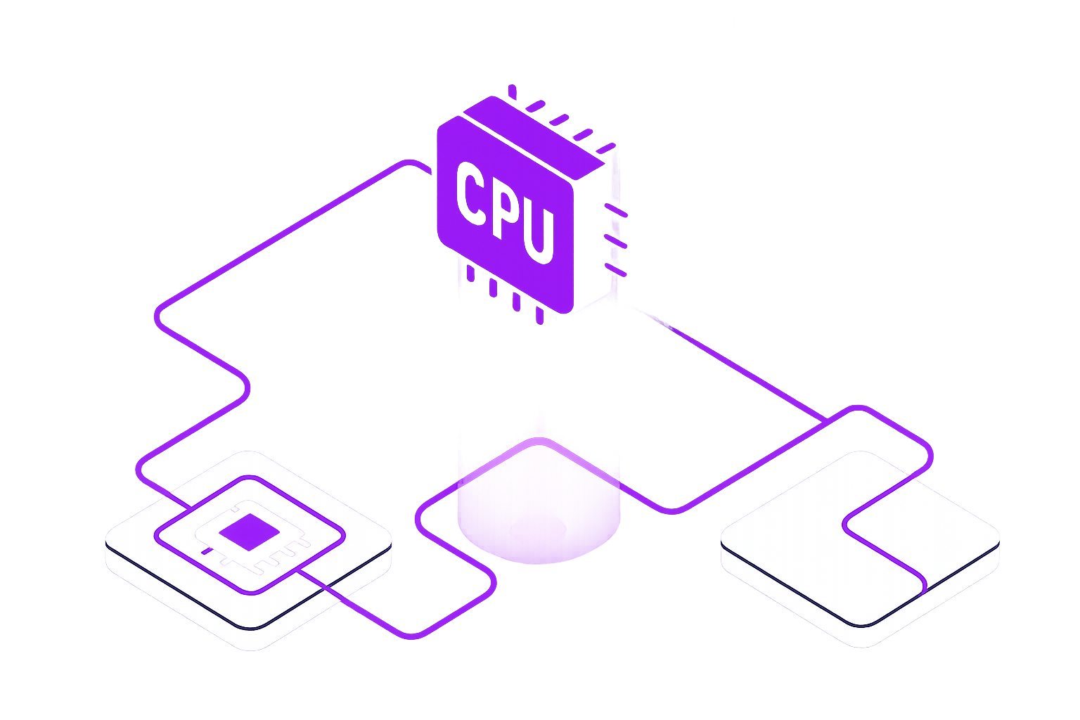
Drafter: "Lightweight vMotion™ for the cloud"

Slide 13
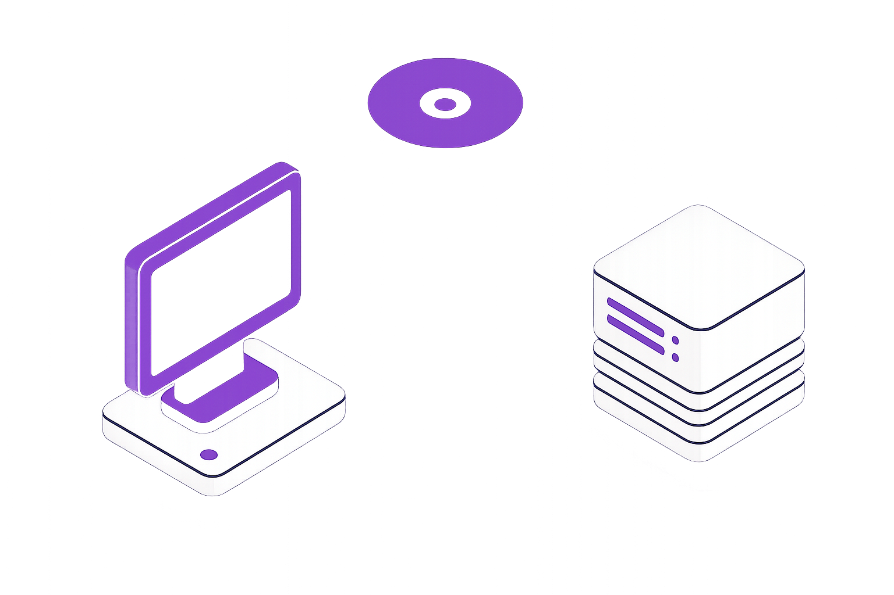
Silo: The Data Plane

Slide 14
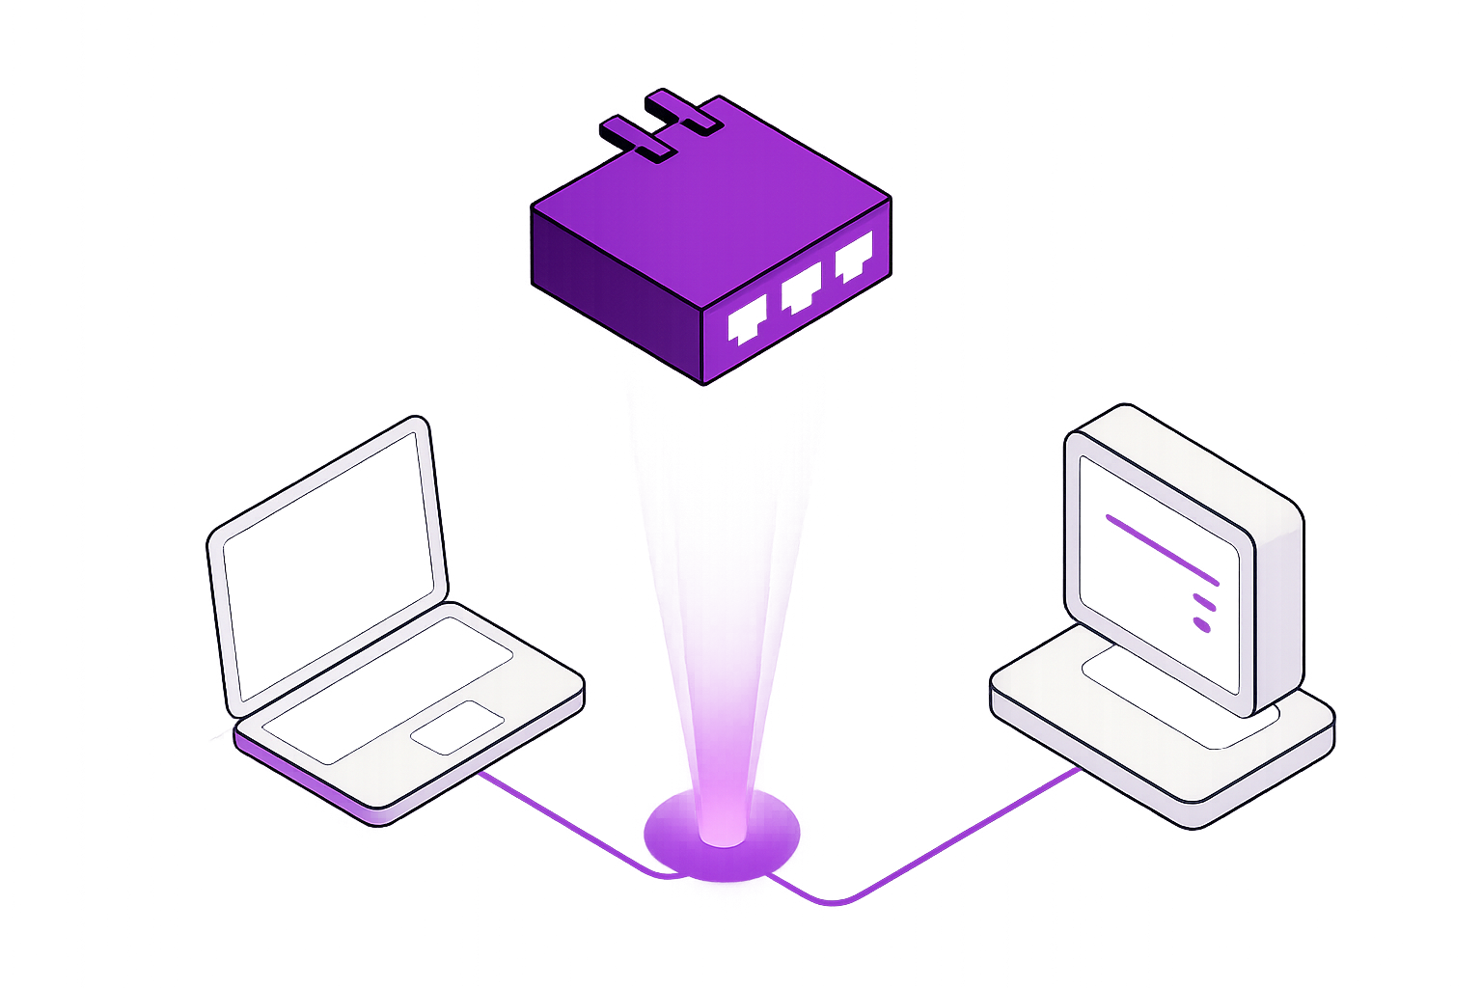
Conduit: Network Migration

Slide 15
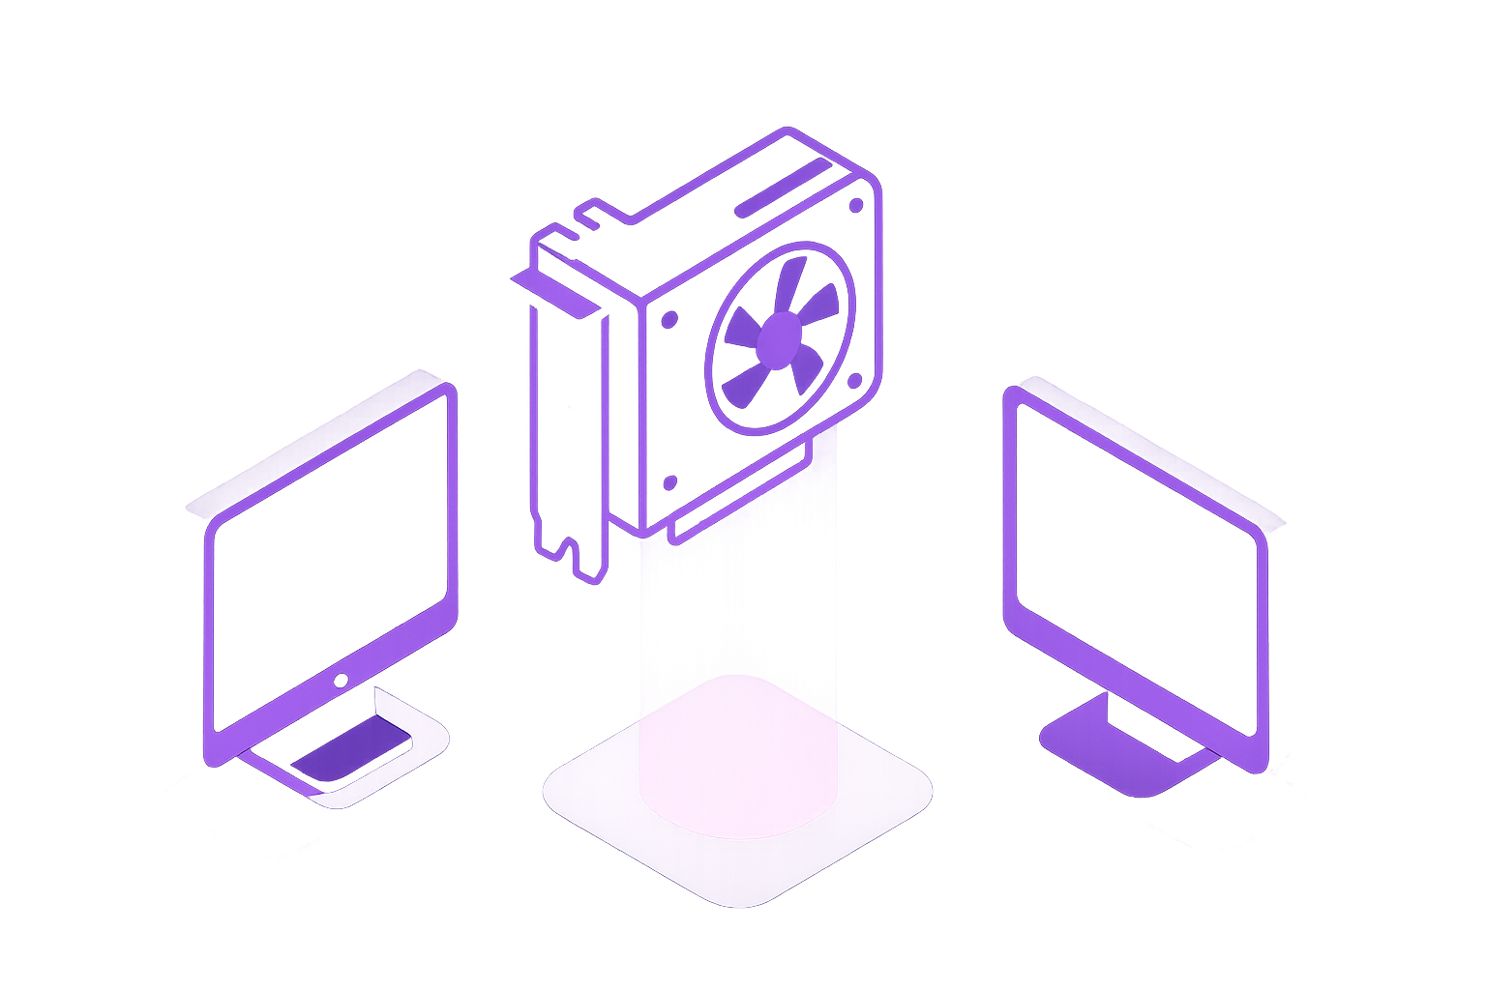
Mirage: GPU Workload Migration

Slide 16
Migration Policy Engine
Cost optimization
Cross-availability zone redundancy
Real-time orchestration
Preemption response
Resource matching

Slide 17
Demo:
Live Migrating a Fuzzing Workload Across Cloud Providers Using Architect

Slide 18
With 90% lower compute costs, you can:
Build more reliable software
Run 10x more tests
Find more bugs where it matters

Slide 19
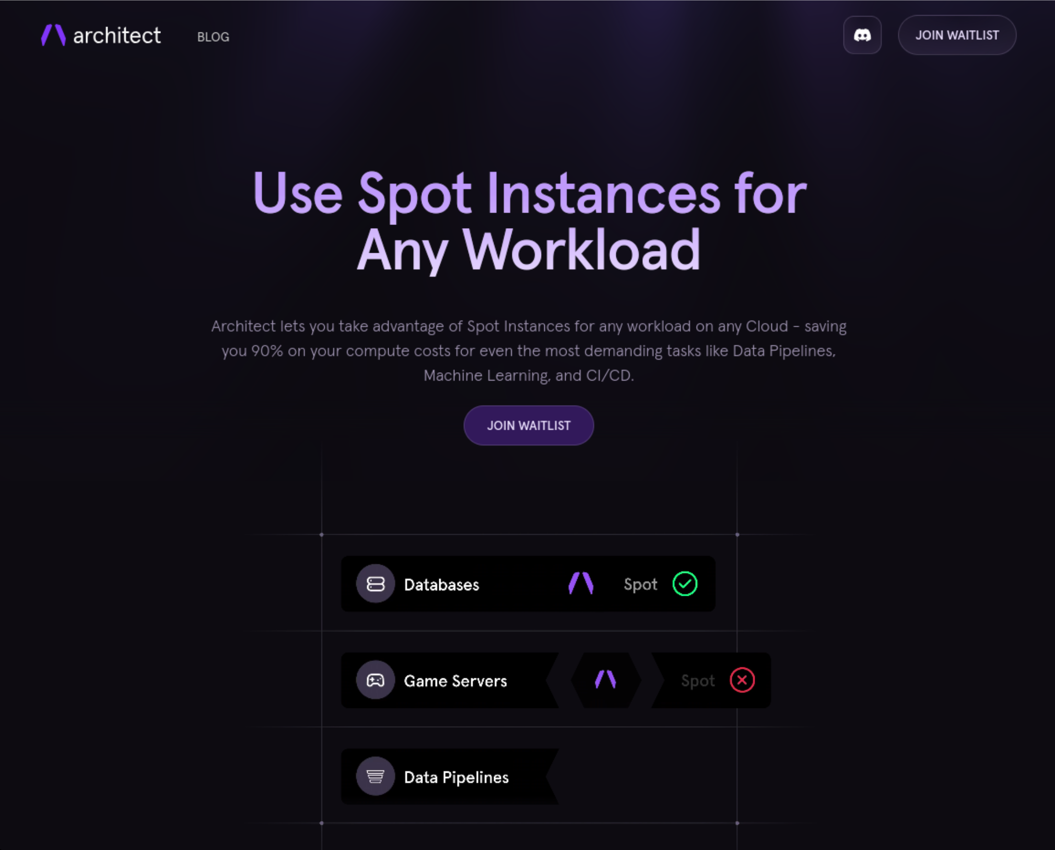

https://architect.run/

Slide 20
Felicitas
Pojtinger
Fediverse:
Bluesky:
Github:
LinkedIn:
Web:
@pojntfx@mastodon.social
@felicitas.pojtinger.com
@pojntfx in/pojntfx felicitas.pojtinger.com

Slide 21
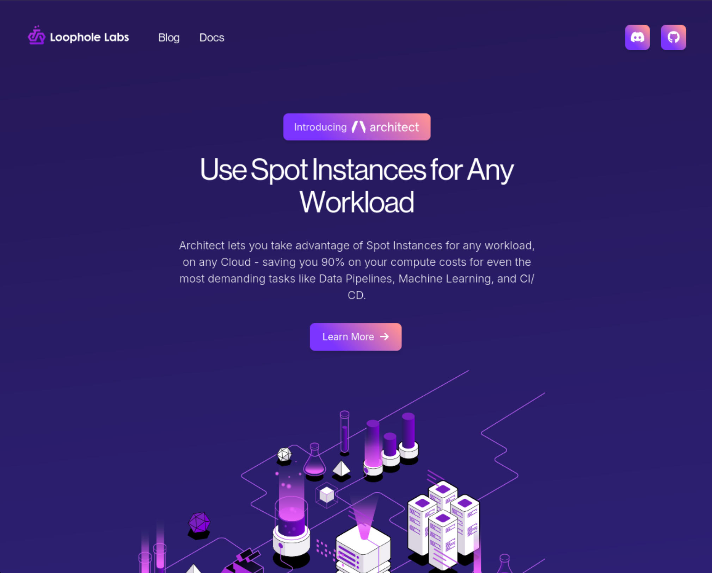

https://loopholelabs.io/

Slide 22

Links and Resources
https://loophole.sh/bugbash2025

